Slide 1
DATA STRUCTURES LABORATORY
Lab Session 7 (convert Infix expression to Postfix expression)

Slide 2
Session No. | Programs | Page No.
1 | To find the length of a string To concatenate two strings To copy a string to another string To reverse a string
2 | To generate “n” terms of the Fibonacci series To find the GCD of two numbers
3 | To insert an element at a given position in an array To delete an element from a given position in an array To perform Bubble sort
4 | To perform Insertion sort To perform Selection sort
5 | To perform Linear search To perform Binary search
6 | To perform stack operations
7 | To perform Queue operations
8 | To perform circular Queue operations
9 | To convert Infix expression to Postfix expression
10 | Insertion of elements to a linked list
11 | Deletion of elements from a linked list
12 | To create a binary tree and perform tree traversal

Slide 3
To convert Infix expression to Postfix expression
One of the applications of Stack is in the conversion of arithmetic expressions in high-level programming languages into machine-readable form. As our computer system can only understand and work on a binary language, it assumes that an arithmetic operation can take place in two operands only e.g., A+B, C*D,D/A etc.
These complex arithmetic operations can be converted into polish notation using stacks which then can be executed in two operands and an operator form.
Infix Expression
Postfix Expression

Slide 4
Infix Expression
It follows the scheme of <operand><operator><operand> i.e. an <operator> is preceded and succeeded by an <operand>. Such an expression is termed infix expression.
E.g., A+B
Postfix Expression
It follows the scheme of <operand><operand><operator> i.e. an <operator> is succeeded by both the <operand>.
E.g., AB+

Slide 5
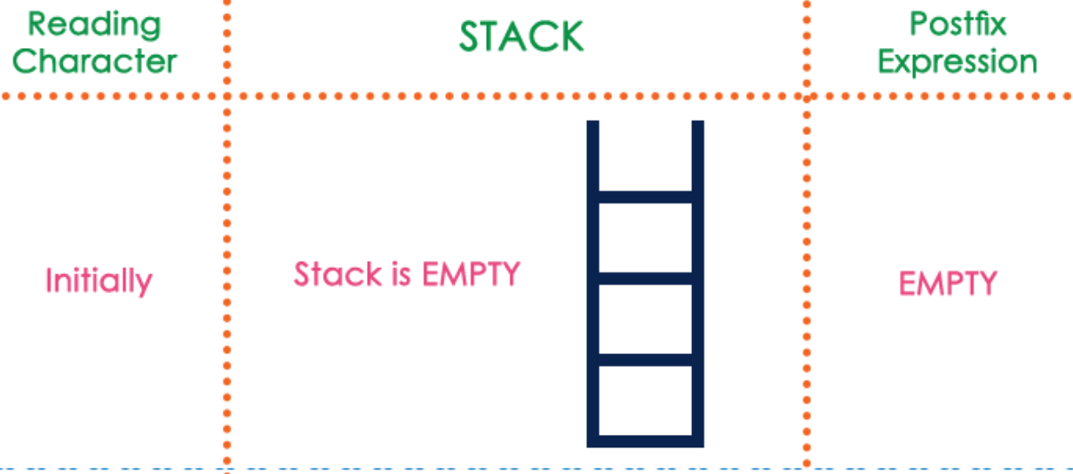

Slide 6
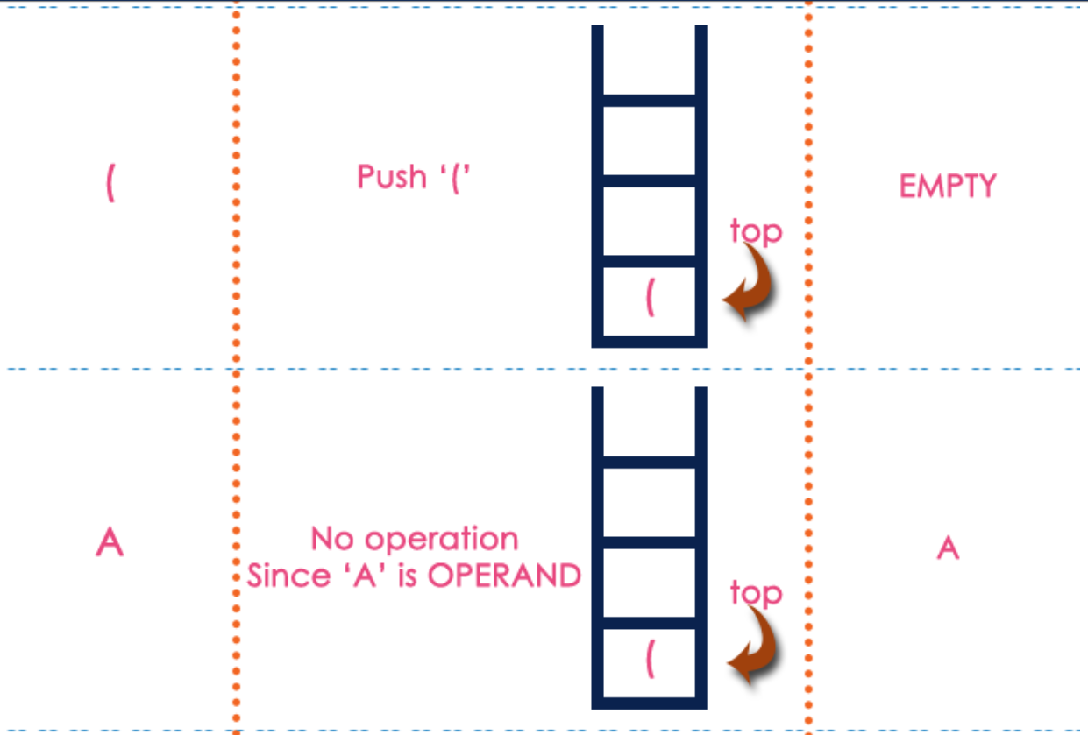
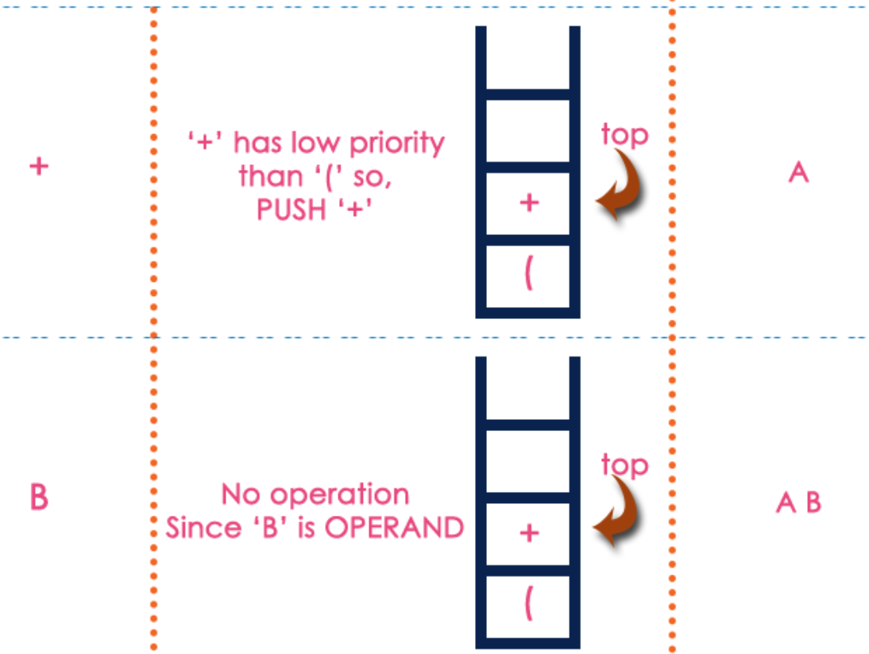
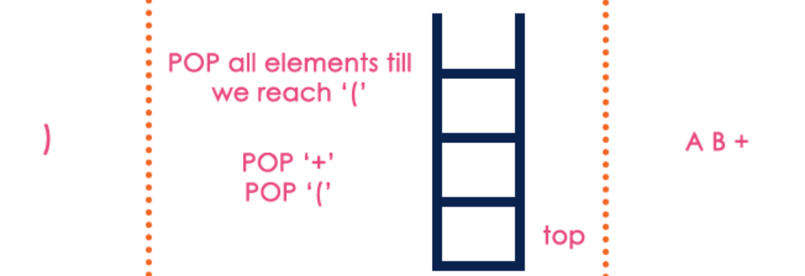

Slide 7
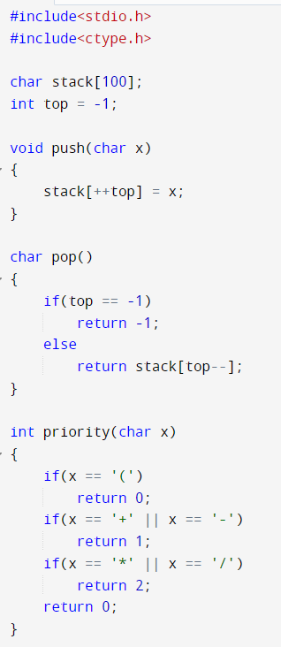
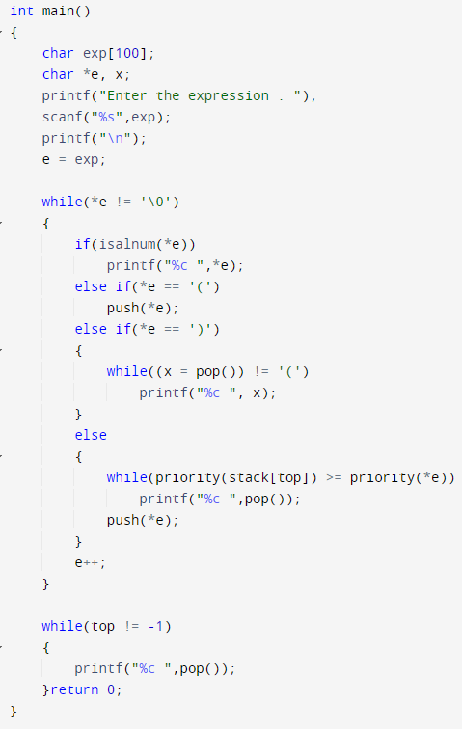
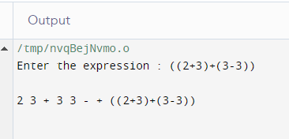
EX: (2*3+4*(5-6))

